Slide 1
Basics of DBMS

Slide 2
A database is a computer based record keeping system whose over all purpose is to record and maintain information.
4

Slide 3
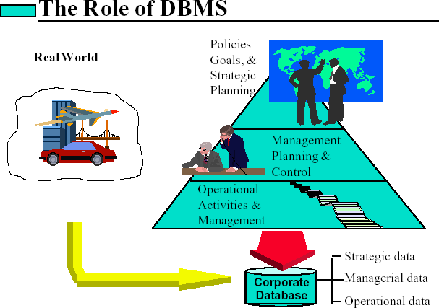

Slide 4
(DBMS) Database Management System
Term Database requires understanding of DATA and INFORMATION

Slide 5
What is Data ?
Data is stored facts.
Data may be numerical data which may be integers or
floating point numbers, characters, date and etc., Eg :
98
89
87
92
and non-numerical data such as
phy chem maths biology
The above numbers may be anything: It may be distance in kms or amount in rupees or no of days or marks in each subject etc.,

Slide 6
What is information ?
Information is RELATED DATA
phy 98
chem 89
maths 87
biology 92

Slide 7
Difference between Data and Information?

Slide 8
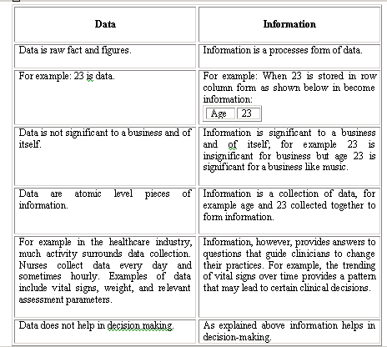
10

Slide 9
DATABASE
phy 98
chem 89
phy 76
chem 87
maths 79
maths 87
biology 92
biology 88
phy 86
phy 91
chem 80
maths 79
chem
67
maths 87
biology 88
biology 77

Slide 10
What is DBMS ?
(DataBase Management System)
A collection of programs that enables you to store, modify, and extract information from a database.
The general purpose of a DBMS is to provide for the definition, storage, and management of data that can be shared by many users.
E.g. ORACLE's database management system is patterned on the relational model described by Dr. E. F. Codd.

Slide 11
So………….
The related information when placed is an organized form makes a database.
Database is a collection of information organized in such a way that a computer program can quickly select desired pieces of data.
The organization of data/information is necessary because unorganized information has no meaning.

Slide 12
Operations on Databases
To add new information
To view or retrieve the stored information
To modify or edit the existing information
To remove or delete the unwanted information
Arranging the information in a desired order
etc.

Slide 13
Manual database and its problems
Wastage of skills and intelligence of human beings on repetitive calculations.
Error prone.

Slide 14
Database and Computers
Large storage capacity
It has high speed
Computer is more accurate.
There are two approaches computers such as File
for storing data in based approach and
Database approach.

Slide 15
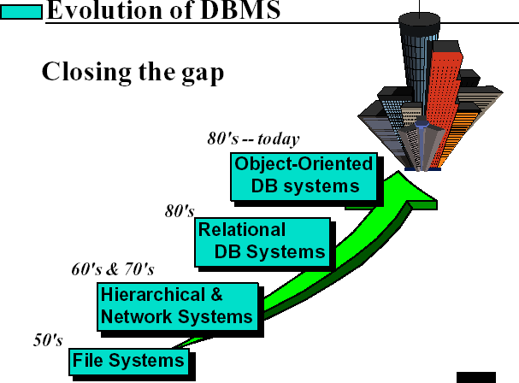

Slide 16
File Based Approach
File-based systems were an early attempt to computerize the
manual filing system that we are all familiar with.
File systems may use a storage device such as a hard disk or CD-ROM and involve maintaining the physical location of the files.
Programmers used programming languages such as C, C++ etc. to write applications that directly accessed flat files to perform data management services and provide information for users.

Slide 17
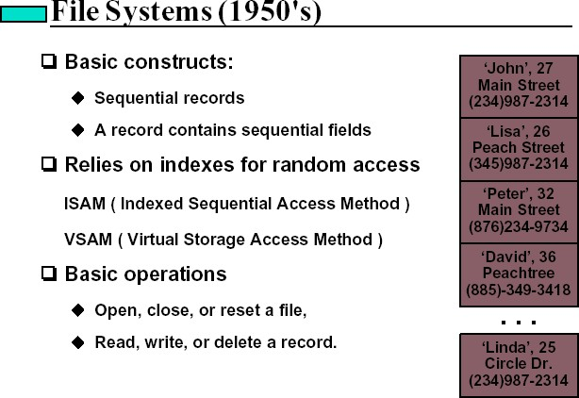

Slide 18
Limitations of the File-Based Approach
Separated and Isolated Data
Duplication of data
Data Dependence
Difficulty in representing data from the user’s view
Data Integrity
Incompatible file formats
Data Security

Slide 19
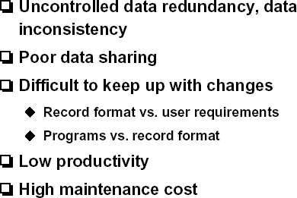

Slide 20
Database Approach
Database is a collection of information organized in such a way
that a computer program can quickly select desired pieces of data.
A DBMS is the software system that allows users to define, create and maintain a database and provides controlled access to the data.
A database management system (DBMS) is basically a collection of programs that enables users to store, modify, and extract information from a database as per the requirements.

Slide 21
Examples of Database Applications
The following are main examples of database applications:
Computerized library systems
Automated teller machines
Flight reservation systems
Computerized inventory systems
Banking Systems
Smart Hospital Systems

Slide 22
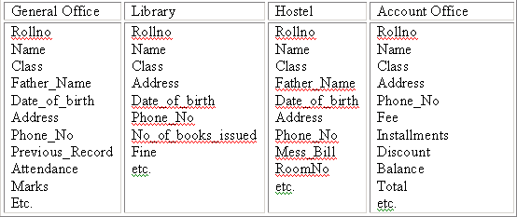
Example
University Database in File Based System
24

Slide 23
Advantages of DBMS
Controlling Redundancy
No duplication
Integrity can be enforced
Integrity of data means that data in database is always accurate, such that incorrect information cannot be stored in database.
Inconsistency can be avoided
When the same data is duplicated and changes are made at one site, which is not propagated to the other site, it gives rise to inconsistency and the two entries regarding the same data will not agree.
Data consistency can help ensure that data remains uniform across all systems, while Data Integrity can help ensure that data remains accurate, reliable and error-free throughout its life cycle. By focusing on these aspects, organizations can maintain high-quality data that supports informed decision-making.

Slide 24
Advantages of DBMS
Data can be shared
Providing Backup and Recovery
Standards can be enforced
Restricting unauthorized access
Solving enterprise requirement than individual requirement

Slide 25
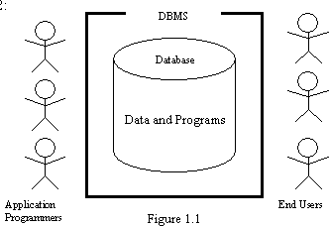
Components of the DBMS Environment
Hardware
Software
Data
Users
Procedures

Slide 26
Disadvantages of DBMS
Complexity
Size
Performance
Higher impact of a failure
Cost of DBMS
Additional Hardware costs
Cost of Conversion

Slide 27
Thank You

